Slide 1
TDL: Enabling Effective Coordination Between Forward Air Controllers and Close Air Support
Raymond Sebetoa (presenter)
Docas Nwanebu
Linda Malinga
Cobus Venter
9th MICSSA, CSIR ICC, 23 August 2023

Slide 2
Outline:
Background: Towards TDL-based FAC-CAS Operations
TDL in South African National Defence Force
Purpose of the Research
Overview of TDL–Based FAC-CAS system
Overview: CAS Briefs
TDL-Based FAC-CAS Experiment
Conclusion
Recommendations

Slide 3
Towards TDL-Based FAC-CAS
The coordination between the FAC and CAS pilot is crucial for the successful execution of the missions, For Example: to prevent fratricide
Require Accurate and Timely Data exchange
Legacy and sometimes current FAC-CAS are based on voice
Susceptible to the inefficiencies of such a communication system
Move to augment or replace voice for FAC-CAS operations
Speech to Data
Multimedia (video, images, and data)
Tactical Datalink based
Notes:
Close Air Support (CAS) is a military tactic in which aircraft provide direct and immediate air support to ground forces engaged in combat, often targeting enemy forces, positions, or assets in close proximity to friendly troops
FAC is a process used in military operations to coordinate and direct the use of airpower in support(such as airstrikes or reconnaissance) of ground forces.
The FAC communicates with aircraft pilots, often over radio or other communication channels, to relay information about the target, the mission objectives, and any potential threats in the area.

Slide 4
TDL in the South African National Defence Force
There are several TDL standards
Example: Link-16 which is used by some NATO nations(most popular)
South Africa was not able to acquire the NATO standard Link-16
South Africa developed an indigenous tactical datalink specification, Link-ZA
Had to develop Interoperability capability based on the Link-ZA
TDL use allows inter-communication across military platforms
Enables experiments such as the mission control, forward air control and overall situational awareness
Notes:
TDL is a communication Network that uses a data link standard in order to provide communication through radio frequency communication
Link-ZA is the data communication component of the "Combat Net Interoperability Standard" (CNIS)

Slide 5
Purpose of This Study
Objective
To develop, experiment and analyse a digitally-aided FAC system based on the Link-ZA standard to support and augment CAS operations for SAAF
Purpose
To get insight into the development of a TDL FAC system using Link-ZA
To recommend to the Defence, on the feasibility of enhancing interoperability in the Defence through TDL-based systems
On-Going effort

Slide 6
Overview of TDL –Based FAC-CAS system
FAC (software):
The FAC application (user interface and backend processing) implements the 9-Line brief to automate the FAC process.
Gateway-GW (software):
For interoperability(data fusion with a common data model) between the Link-ZA-compliant nodes.
RF System (hardware and software):
A Link-ZA-compliant UHF radio used to exchange digitized tactical.
Simulated CAS Platform UHF radio:
A CAS platform or node fitted with the compatible Link-ZA.

Slide 7
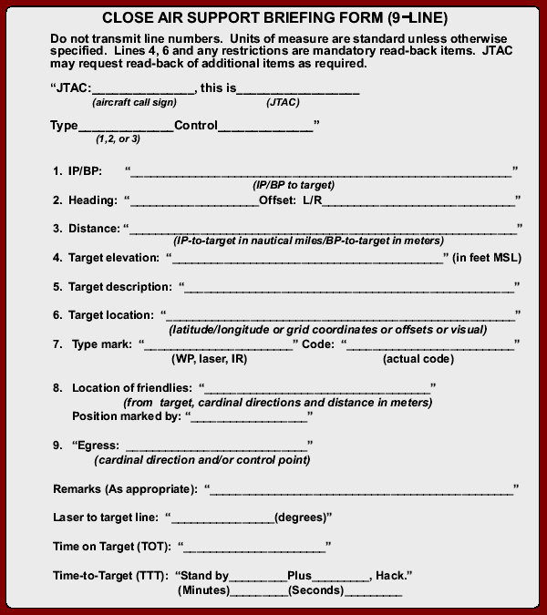
Overview: CAS Briefs
Standardised doctrines are already in place to ensure smooth communication between FAC and CAS pilots.
One tool that helps with clear communication between soldiers on the ground and aircraft is the 9-Line CAS Brief.
Every mission is unique, as are the tools and briefs tailored for them. For example, there’s the Close Combat Attack (CCA) brief (5-line CAS Brief).
U.S. Joint Chiefs of Staff, “JP 3-09.3 Close Air Support,” no. November 2014, p. 361, 2014, [Online]. Available: https://fas.org/irp/doddir/dod/jp3_09_3.pdf.

Slide 8
TDL-Based FAC-CAS Experiment
Data Mapping and Selective Digitization
A process of selecting which messages to digitize and which not to digitize in order to strike a balance in overall performance.
Data Transfer and Accuracy test
Comparative analyses of voice-based and datalink-based exchanges underscored the higher accuracy and reliability of datalink transmissions.
Data Exchange Latency test
This test aimed to assess the latency experienced during tactical data exchange.
Different Configurations test
Experimenting with various transmission methods, including transmitting the 9-Line CAS brief as an image, highlighted the benefits of preserving data integrity, simplicity, and context.

Slide 9
TDL-Based FAC-CAS Experiment - Selective Digitization
Selective Digitization
By selectively digitizing components of the 9-Line CAS brief, we aimed to strike a balance between automation and maintaining essential voice-based interactions.
# | Selective digitization of the 9-Line brief (main parameters)
 | 9-Line brief | Datalink | Voice
0 | Type and Control | X
1 | IP/BP | X
2 | Heading | X
3 | Distance | X
4 | Target Elevation | X
5 | Target Description |  | X
6 | Target Location | X
7 | Type Mark | X
8 | Location of friendlies | X
9 | Egress | X
Selective digitization of the 9-Line brief Remarks parameters
9-Line brief Remarks | Datalink | Voice
Remarks (As Appropriate) |  | X
Laser-to-Target line (LTL) – in degrees and magnetic | X
Time-on-Target (TOT). | X
Time-to-Target (TTT). | X
Notes:
Those left on voice. This is due to the sensitivity and importance of its content, and it is so to ensure clarity and immediate feedback, which will ensure mutual understanding and reduce misinterpretation.

Slide 10
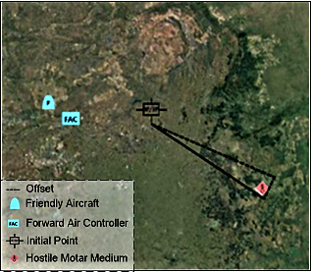
TDL-Based FAC-CAS Experiment - Software
Software based 9-line CAS Brief
In-time data exchange
Automated calculations
FAC’s situational awareness (enhanced reconnaissance)

Slide 11
TDL-Based FAC-CAS Experiment - Tests
Data Transfer and Accuracy
Datalink exchanges outperformed traditional voice-based communication in terms of data accuracy and completeness (subjective).
Data Exchange Latency
Our software-based gateway system showcased its ability to foster interoperability, thereby enhancing operational efficiency.
Different Configurations
Image vs individual massages
Exchanged messages from the FAC to the CAS Pilot
Message Category | Voice | Datalink
Free text messages | X | X
Own Position messages | X | X
Surface Track Messages | X | X
Target Allocation | X | X
Image (not part of the 9-Line CAS brief form) | N/A | X
Notes:
Integrity of Information: An image preserved the spatial arrangement and relationship between the brief lines. This ensured that the CAS pilot node saw the information in its original format.
Efficiency: Sending a single compressed image was faster and more efficient than sending multiple text messages at a specific interval.
Simplicity: One image proved to avoid the potential of missing one of the individual messages or having them arrive out of sequence, which may be due to transmission delays.
Context: Visually presenting the entire 9-Line CAS brief allowed for an immediate understanding of the complete information without waiting for all separate messages to arrive sequentially

Slide 12
Conclusion and Future Work:
The recent military developments and conflicts has highlighted the importance of military capability development sovereignty, and South Africa is no exemption
This study shared insights into the ongoing development of a digitally aided FAC system using a specific datalink to support CAS operations.
Pointed out the importance of selective digitization of the CAS-FAC process
Demonstrated and highlighted that Link-ZA can be an enabler for datalink CAS-FAC operations, using protocol gateways and selective digitization of the FAC process.
Highlighted the benefits of digitizing operation and processes
It contributes to the transformation of Defence capabilities towards the modern, digital, and interconnected capabilities brought enabled by datalink.

Slide 13
Recommendations:
Further experiments needs to be conducted with actual SANDF Link-ZA-compliant platforms.
For compatibility tests and developments based on the capabilities of each platform
Implement actual FAC process based on the SANDF CAS brief or doctrine.
Field tests with qualified qualified forward air controllers and pilots.
Other processes can take this study and other related study as an entry to digitizing voice-based operations using the Link-ZA.
An ongoing effort to inter-connected operations to improve situational awareness for a modern and enhanced command and control.

Slide 14
Questions?

