Slide 1
Agile Thinking towards Information and Communication Technology (ICT) Capability Development through Project Management in Defense
Presentation by Lt Col S.D. Filmalter
August 2023

Slide 2
Aim
To present a project management framework for ICT projects in the DOD to support the development of ICT capabilities

Slide 3
Scope
Aim
Introduction
Defense
Project Management
Capability Development
Agility
Projects for ICT Capabilities
Towards the Future of ICT Capability Development
Conceptual Framework
Conclusion
Further reading
Questions

Slide 4
Introduction (1/2)
There is a noticeable and growing trend of project failures. These failures are likely to have a negative impact on organizations' ability to achieve their goals and deliver successful projects to develop capabilities.
These failures are closely linked to organizational frameworks. The large number of unsuccessful projects demonstrates that current personnel, methods, and strategies are insufficient to guarantee success.
Investigations into the causes of ICT capability development failures showed that organizations have a history of failing to learn and apply lessons.
There is an intricate nature of managing ICT projects and capability development, especially within the challenging context of defense organizations.

Slide 5
Introduction (2/2)
The integration of rapidly evolving technologies, combined with the need to meet rigorous command and control (C2) requirements, creates unique complexities that require strategic planning, effective project management, and a balance between innovation and regulation.
The success of project management in handling ICT initiatives within an organization is contingent upon recognizing and navigating the various economic, political, and social factors at play.
An organization's ability to adapt its project management practices to these elements can ultimately influence the outcome and impact of its projects to develop ICT capabilities.

Slide 6
Defence
In comparison to any other organization, defense organizations are viewed as special due to the kind of individuals and organizational structures that support how things are carried out. C2 is a significant aspect that differentiates defense organizations from other types of organizations.
While C2 is a crucial factor in defense operations, a conflict exists between the self-determining requirements of stakeholders and their position inside the organization. The conflict between what the organization wants and what project methods can produce is the constant issue.
In order to support the implementation of strategic projects and the development of capabilities, defense organizations like the DOD are now making the most of project management processes.
The success of an enterprise like the DOD in managing the development of its ICT capabilities depends on top management's agreement and accommodation of the necessary project management approach.

Slide 7
Project Management (1/2)
There is a necessity to address the evolving needs for project management and execution within defense organizations, particularly in response to the changing nature of combat and shifting objectives.
The challenges arise from the need for adaptable project organizations and the requirement for scaling agility in project management practices to efficiently deliver solutions.
ICT initiatives focused on developing capabilities within defense organizations require a distinct project management methodology. Additionally, the importance of project success within the military context and the potential for adopting hybrid techniques if existing project management practices do not align with the unique demands of defense projects should be considered.

Slide 8
Project Management (2/2)
The various methodologies were analyzed to determine which were the most suitable.
It has become abundantly clear through the comparison of the top project management methodologies that a combination of some of these including PMBOK, Process-Based Project Management, PRINCE2, XPM and Benefits Realization, may be the best course of action for defining how the DOD could bring agility to the development of ICT capabilities.
The preferred five methodologies are the most appropriate because they are: (1) structured; (2) appropriate for large organizations; (3) create the necessary audit trail; (4) allow for the achievement of objectives; and (5) can be aligned to the formal structures of organizations like those in defense environments, with particular reference to the DOD.
Notes:
Discuss the advantages and disadvantages table
PMBOK
Advantages:
• PMBOK, like PRINCE2, is an internationally recognised methodology and is widely used in the USA.
• PMBOK applies an international standard to the Waterfall method (sequential flow) and is a concise methodology that can be used to manage large projects.
• It supports work in a standardised way across departments and institutions.
• It brings about standard terminology and - practices to project management.
Disadvantages:
• PMBOK, like PRINCE2, is not suitable for smaller institutions that want to work at a faster pace and is complicated due to its conciseness.
Adaptive (Agile) Project Framework
Advantages:
• Agile allows for high flexibility in a project as its name suggests and is done using repetitions that allow the project to continually adapt to the needs identified.
• Because the process is flexible no time and resources are wasted for a full project that could be rejected as deliverables are delivered in pieces constantly.
• Agile has a high satisfaction index as feedback is essential and the customer has a strong impact on the development project.
• Cross-pollination and interaction during the process prevent duplication of activities.
• Continuous quality assurance and attention to detail are maintained since delivery is over short cycles.
Disadvantages:
• Agile normally has numerous small teams, the workflow coordination becomes a problem, which creates a huge amount of communication that needs to be considered before any work can be done. Thus, communication becomes a disadvantage.
• Part of the detailed planning that is needed is to have professional teams in place that can take serious decisions when required before the process can start. This means only experienced members are suited and can take decisions.
• Agile delivers in short cycles there is a lack of long-term planning, which could create a lack of vision, especially within institutions that follow a strategic long-term focused thinking approach.
• The constant role the customer plays can derail the project due to demanding changes during the process.
• This way of working requires numerous small teams there is the problem that all pieces must be integrated at the end, which might then require further changes to make everything work.
• This method is weak in documentation due to the hands-on nature of customer interaction which mostly is verbal.
Event Chain Methodology
Advantages:
• In the mapping of resources, you know who is available for what part of a project, making collaboration easier.
Disadvantages:
• Time allowances are built into each part of the project plan and thus this method will not work well for smaller projects with quick turnaround times.
Extreme Project Management (XPM) Advantages:
• This method allows institutions to save costs and time in project realisation since the focus is on the delivery of the final product.
• Money is saved as less documentation is generated as problems are solved through discussion within the team.
• Simplicity is a preference throughout the process, which allows for improvements at any time.
• The process is visible and in turn brings accountability.
• Constant feedback throughout is strong.
• This method supports the development of software faster due to allowing change and regular testing.
Disadvantages:
• This method is focused on code and not design, thus creating problems as good designs in software projects are crucial.
• Documentation is sparse and may lead to problems down the line.
• XP does not measure quality assurance which could cause problems and defects later on.
Lean
Advantages:
• Ideal and easy to use in manufacturing and production that deliver physical products.
• There is the elimination of disused inventory and waste.
• Lean allows for strong customer relationships.
Disadvantages:
• Traditional methods that are becoming less relevant today.
Process-Based Project Management
Advantages:
• Improved project processes, which in turn increase the value and benefits of the project results at reduced costs.
• Project alignment with the institution’s strategic vision.
• Institutions gain flexibility and processes are cross-cutting in that they reach different services within the institution.
• Project roles and responsibilities are clearly defined to support the achievement of the goals of the institution.
• There is optimised use of resources, which in turn reduces management and operational costs.
• This process supports improvement in that deficiencies are quickly identified, and the associated risks reduced.
Disadvantages:
• This approach when implemented is a change for a traditional hierarchical institution and thus change management is crucial for success.
• This methodology must be applied to the whole institution and not just single entities.
PRINCE2
Advantages:
• PRINCE2 is the most used methodology in the world and thus tried and tested.
• Common and understandable terminology for all projects.
• It maps out phases of large projects from beginning to end, highlighting what will be delivered.
• There is a focus on extensive documentation which allows for lessons learnt and auditing of projects.
Disadvantages:
• PRINCE2 is very rigid like all Waterfall methods, in that nothing will take place unless the preceding step has been done.
• It is not for small projects or institutions that don’t have the time or resources to manage projects.
• The extensive amount of documentation creates a disadvantage in that changes are hard to accommodate, and documents must be redone, tying up resources that could hamper progress and deliverables.
Benefits Realisation
Advantages:
• Benefits Realisation supports the success of projects that bring about change due to the focus being on the added value the project brings.
• It provides a practical ‘framework’ for ensuring real results.
Disadvantages:
• Institutions do not find this method easy as managing benefits formally is a problem in institutions as shown in the literature as to why projects fail.
• Members within institutions do not always understand what benefits versus objectives are, as the achievement of objectives leads to the realisation of benefits.
• The structuring of benefits realisation needs to be simplified and clearer for a better understanding.
• Accountability for benefits is not formally defined.
• This method needs the active management of project plans.

Slide 9
Capability Development
ICT capability development refers to the strategic and systematic efforts undertaken by organizations to enhance their ICT-related skills, resources, and capacities.
It involves a comprehensive approach to improving an organization's ability to effectively and efficiently leverage ICT to achieve its goals and objectives.
Key aspects of capability development for ICT include: skills enhancement, infrastructure improvement, upgrading and maintaining ICT infrastructure, strategic planning, innovation and research, change management, cybersecurity, communication and importantly project management.

Slide 10
Agility
Agility encompasses attributes such as speed, cost-effectiveness, flexibility, and quality.
The challenges of rapid technological change, which impacts everything from communications to computer networks to cyber security, have heightened calls for increased agility in defense procurement of ICT capabilities.
The DOD risks lagging behind its partners and adversaries unless they find methods to become more agile when obtaining capabilities that rely on fast-moving technical breakthroughs.
The agility and flexibility of the DOD to adjust to a fast evolving and continuously changing environment is becoming as crucial as is investing in new ICT capabilities.

Slide 11
Projects for ICT Capabilities
In recent years, defense organizations, including the DOD, have started to leverage project processes to support efficient decision-making and the execution of critical programs.
The relevance of project management in the modernization of the military industry, which faces several obstacles, has grown in recent years.
Many organizations utilize project management to boost productivity, implying that it is best suited to address support procedures for capabilities and product systems, hence increasing the organization's ability to fulfill its goal.

Slide 12
Towards the Future of ICT Capability Development
ICT Capabilities are essential enablers of the coordination mechanisms that must be included in the DOD's capacity building since they are the primary component of the DOD's response to crises, whether they are caused by natural or man-made disasters or post-conflict.
ICT skills and requirements need to be better understood in order for all parties working with the DOD to effectively develop and coordinate their efforts.
As the DOD is a bureaucratic institution, barriers must be removed to support enablement through these coordinated efforts.
The DOD might thus significantly benefit from a revised or altered project culture and approach to project management for the development of ICT capabilities.

Slide 13
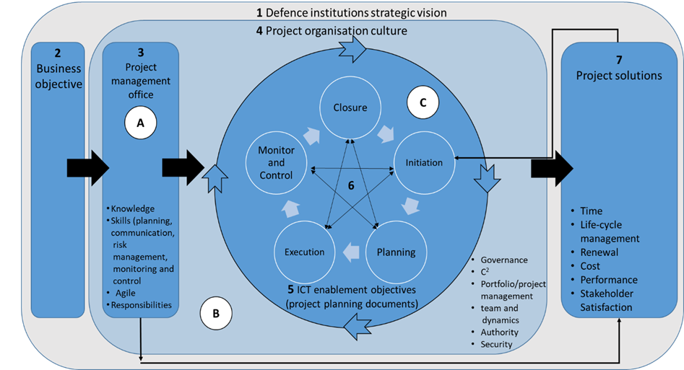
Conceptual Framework
(Source: Filmalter & Steenkamp, 2022)

Slide 14
Conclusion
One of the critical criteria for the stabilization and future defense focuses in a journey to greatness is the renewal and optimization of the DOD's ICT.
In light of the environment of a defense organization, where projects for ICT capabilities are managed bridging the gap between generic project management approaches in use and those for the development of ICT capabilities is required.

Slide 15
Further Reading
D.L. Hughes, Y.K. Dwivedi, N.P. Rana and A.C. Simintiras, 2016. Information systems project failure–analysis of causal links using interpretive structural modelling. Production Planning & Control. 27(16):1313-1333.
E. Cohen, 2017. Project Management Methodologies: Everything You Need to Know. [Online] Available at: https://www.workamajig.com/blog/project-management-methodologies
Gartner 2016. Gartner Says Worldwide IT Spending is Forecast to Grow 0.6 Percent in 2016. Stamford, CT: Gartner Press Release on January 18, 2016.
G. Sudhakar, 2016. Critical Failure Factors (CFFs) of IT Projects. The International Journal of Management Research. 4(2).
L. Brown, 2022. Operations Management vs Project Management: What’s The Difference?. Invenis. [Online] Available at: https://www.invensislearning.com/blog/project-management-vs-operations-management/
H. Taherdoost and A. Keshavarzsaleh, 2018. A theoretical review on IT project success/failure factors and evaluating the associated risks. Mathematical and Computational Methods in Electrical Engineering. 80-88.
M. Haseeb, H.I. Hussain, B. Ślusarczyk and K. Jermsittiparsert, 2019. Industry 4.0: A solution towards technology challenges of sustainable business performance. Social Sciences, 8(5), p.154.
The Standish Group. 2014. Chaos. [Online] Available at: http://www.projectsmart.co.uk/docs/chaos-report.pdf
S.D. Filmalter and R.J. Steenkamp, 2022. Towards a project management framework for ICT projects in defense institutions. Scientia Militaria: South African Journal of Military Studies, 50(1):65-89.

Slide 16
Questions

