Slide 1
Application of quantum computers to the simulation
of phase-based quantum biosensing experiments
K. Mpofu and Mthunzi-Kufa
Council for Scientific and Industrial Research (CSIR), Photonics Centre, Pretoria
SAIP Conference 2023
05 July 2023
Notes:
Good morning, everyone, My name is Kelvin Mpofu.
I am going to present my talk titled quantum plasmonic biosensing for enhanced covid-19 detection, but I must point out that for this talk I will not be discussing the covid-19 component of the work rather just focus on the plasmonic biosensing.
The work I will present here is theoretical in nature so there are no experimental results.

Slide 2
Outline of the presentation
Introduction
Introduction to Quantum computing
Features of Quantum Computing (Entanglement)
Applications of Quantum Computers
Mach-Zender Interferometer (MZI)
Plasmonic biosensing setup
Modelling a MZI on a quantum computer
Quantum computer results
Future work
Acknowledgements
Notes:
Here’s a quick outline of the presentation
We will look at an introduction to plasmonic biosensing particularly surface plasmon resonance biosensing.
We will look at the mechanism of SPR, kinetic parameters and applications of SPR.
We will look at the application of a quantum state of light known as the NOON state to phase based plasmonic biosensing, some simulation results and future work.

Slide 3
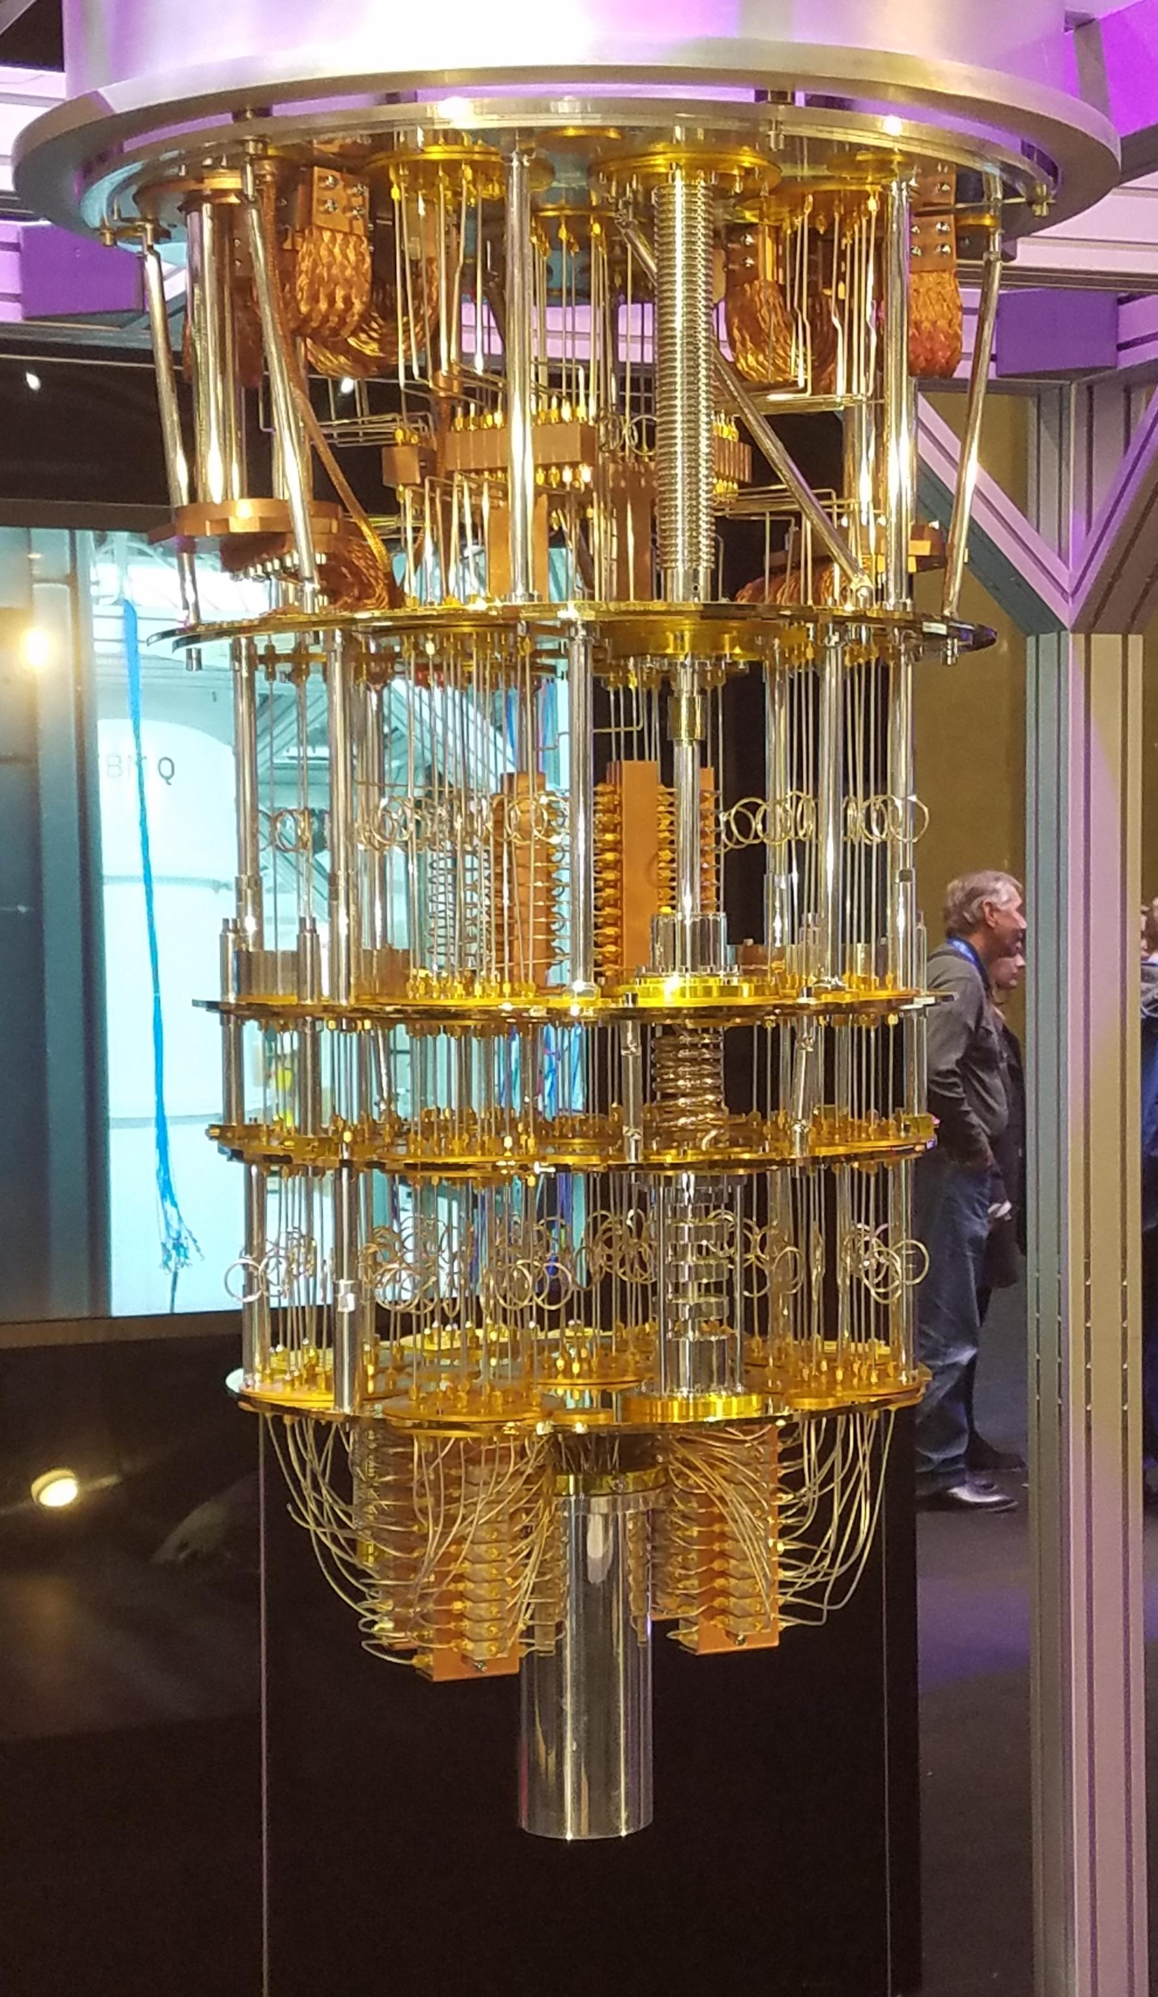
What is a quantum computer?
Quantum computation and quantum information are the study of the implementation of information processing and computing tasks that can be accomplished using quantum mechanical systems.
Quantum computers unlike classical computers use qubits as opposed to bits to encode information (Qubits are the basic unit of information in quantum computing).
As Quantum computers continue to develop, researchers are looking for more potential applications for these devices. In this work we wanted to show that indeed quantum computers can be useful in the modelling of quantum biosensing experiments. (What are sone apps of quantum computers?).
IBM Q Quantum computer

Slide 4
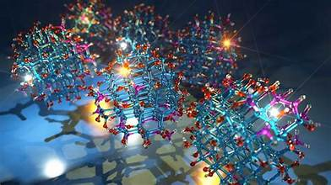
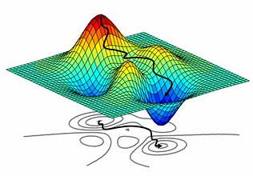
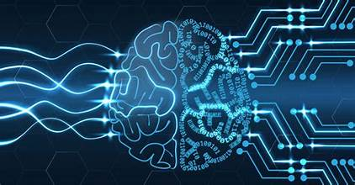
What are the applications of quantum computers?
Material Science
Optimization
Cryptography and Security
Machine Learning
Financial analysis

Slide 5
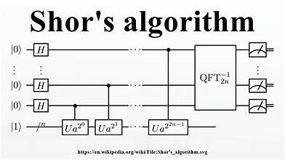
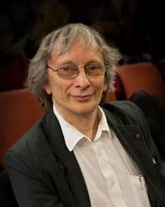
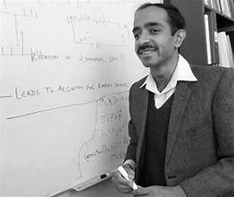
Popular quantum algorithms
Deustch’s algorithm

Slide 6
What advantages do quantum computers present?
Quantum algorithms have been shown to offer as speedup over classical algorithms, for example Grovers search algorithm has been shown to provide a quadratic speed up in searching an unsorted database.
Shor’s algorithm has been shown to give an exponential speedup over classical algorithms in factoring large integers and solving the discrete logarithm problem.
The speedup in the performance of quantum algorithms is particularly due to features or properties of quantum mechanical systems such as entanglement and superposition.
In this work we show case an alternative application of quantum computers in modelling or simulating quantum optical sensing experiments.

Slide 7
What is a Mach-Zender Interferometer?

Slide 8
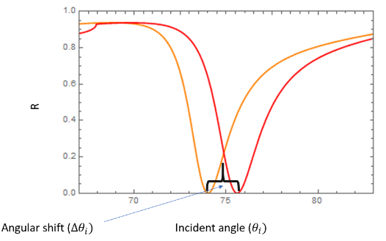
Plasmonic biosensing setup
Analyte flow
Functionalized ligand
Notes:
SPR technology is often utilized for the study of binding interactions between free analyte molecules which are in solution and probe ligand molecules which are bound/immobilized onto the sensor surface.
As molecular binding takes place a shift in reflectivity curve can be observed.
This system can be used to detect the presence or absence of a biological molecule in the sample for instance if we functionalize the surface with a molecule which detects covid -19 then there should only be a shift if the analyte flowing through contains covid-19.

Slide 9
Quantum states in biosensing
In optical biosensing setups the input to the biosensor is usually classical light typically coherent states of light however previous work has shown that using quantum states of light can in fact improve the performance of our biosensors.
Previous work has shown that using quantum states can enhance the sensitivity and precision of biosensors which is critical for biosensing research.
We can model how much using different quantum states can improve the sensitivity of our sensor using quantum computers. This is the objective of this work.

Slide 10
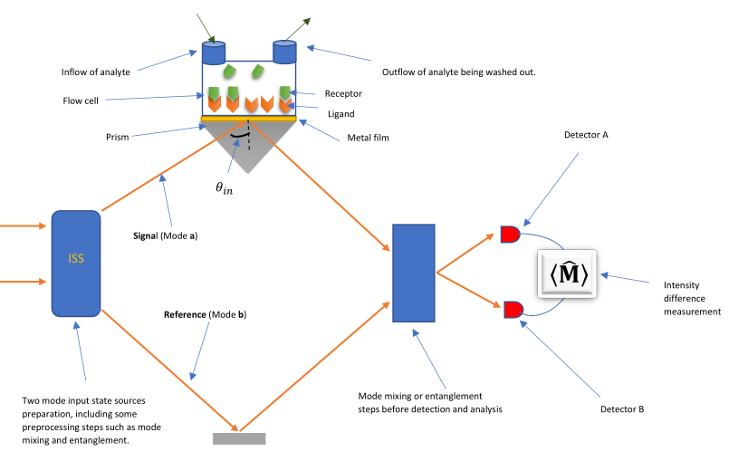
Modelling quantum plasmonic phase-based biosensing as interferometer
In this work we are interested in the application of quantum computers to biosensing.
By placing the plasmonic biosensor into the Mach-Zender interferometer we can interpret the biosensing setup as a phase-based biosensor.

Slide 11
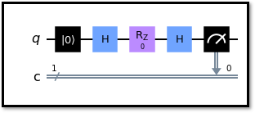
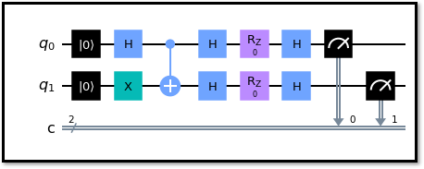
How can a Mach-Zender interferometer be modelled in a Quantum computer with single qubit and entangled qubit system?
Single mode qubit system passing through a MZI.
Entangled two-mode qubit state system passing through a MZI.

Slide 12
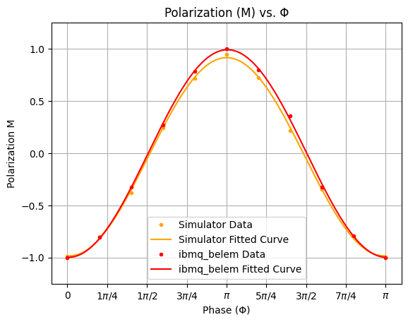
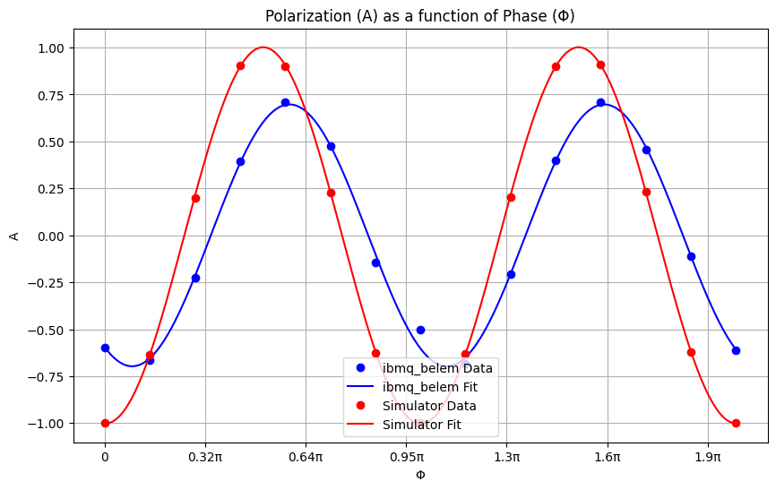
Results from single qubit and entangled two qubit system implementation on an IBM quantum computer.
The polarization measure gives information about the phase sensitivity of the system. Typically, the higher larger the number of curves the more sensitive your system. In the context of biosensing we can optimize the sensitivity of or system by varying the input quantum states till we optimize for the highest sensitivity.

Slide 13
Conclusion
In this work we show a potential alternative use for quantum computers, i.e., simulating phase based biosensing experiments.
Whilst we have explicitly chosen a biosensing experiment this work can be applied to any sensing experiment up to and including the development of radar systems for military applications.
Quantum computers offer a rapid way to simulate phase-based systems and can find applications in biosensing.
In future work we will look at the simulation of phase-based setups using squeezed states and other states of light which can be modelled on the quantum computer.

Slide 14
Acknowledgements

Slide 15
Thank you

