Slide 1
MICSSA
2023
By: Lieutenant Thuthukani Mpontshane

Slide 2
TRANSITIONING TO PAPERLESS DATABASE AND INFORMATION SYSTEMS

Slide 3
OUTCOME
Explain all aspects of Transitioning to Paperless Database and Information Systems according to a comprehensive study on reducing paper usage

Slide 4
SCOPE
Objectives.
Introduction.
Phase One (Current assessment).
Phase Two (Paperless transition & implementation).
Phase Three (Database Integration & Evaluation).
Conclusion.
Q&A

Slide 5
Transitioning to Paperless Database
and Information Systems
Objectives
Introduction
Assessment of current state.
Exploration of User Perspectives.
Quantification of Environmental Impact.
Design and Implementation.
Cost Analysis.
Phase One
Phase Two
Phase Three
Conclusion
Q&A
Digital Transformation in Achieving Defence Information Excellence in the Journey to Greatness

Slide 6
Transitioning to Paperless Database
and Information Systems
Objectives
Introduction
A database is a set of organised, structured data that can be quickly accessed, modified and retrieved.
Paper usage has an unavoidable negative influence on the environment, which has prompted businesses to look for creative solutions for a greener future.
Phase One
Phase Two
Phase Three
Conclusion
Q&A
Digital Transformation in Achieving Defence Information Excellence in the Journey to Greatness

Slide 7
Transitioning to Paperless Database
and Information Systems
Objectives
Introduction
Database is essential for flawless operations in the technology driven world of today.
A practical way to improve efficiency, streamline processes and promote sustainable practices is to implement effective database and information systems.
Phase One
Phase Two
Phase Three
Conclusion
Q&A
Digital Transformation in Achieving Defence Information Excellence in the Journey to Greatness

Slide 8
Transitioning to Paperless Database
and Information Systems
Objectives
Introduction
On the other side, information systems cover the full structure for effectively gathering, storing, processing and disseminating data.
Phase One
Phase Two
Phase Three
Conclusion
Q&A
Digital Transformation in Achieving Defence Information Excellence in the Journey to Greatness

Slide 9
Transitioning to Paperless Database
and Information Systems
Objectives
Introduction
The first phase focuses on quantitative data collection and analysis to gauge the technical performance of the database system. Various metrics including query execution times, system response rates, and resource utilization are measured.
Phase One
Phase Two
Phase Three
Conclusion
Q&A
Digital Transformation in Achieving Defence Information Excellence in the Journey to Greatness

Slide 10
Transitioning to Paperless Database
and Information Systems
Objectives
Introduction
Standardised benchmarks and system logs are utilized to generate objective performance indicators.
Process Mapping.
Workflow Analysis.
Data Audit.
User Feedback.
Environmental Impact Assessment.
Phase One
Phase Two
Phase Three
Conclusion
Q&A
Digital Transformation in Achieving Defence Information Excellence in the Journey to Greatness

Slide 11
Transitioning to Paperless Database
and Information Systems
Objectives
Introduction
Phase One
Phase Two
Phase Three
Conclusion
Q&A
Digital Transformation in Achieving Defence Information Excellence in the Journey to Greatness

Slide 12
Transitioning to Paperless Database
and Information Systems
Objectives
Introduction
Phase One
Phase Two
Phase Three
Conclusion
Q&A
Digital Transformation in Achieving Defence Information Excellence in the Journey to Greatness

Slide 13
Transitioning to Paperless Database
and Information Systems
Objectives
Introduction
Phase One
Phase Two
Phase Three
Conclusion
Q&A
Digital Transformation in Achieving Defence Information Excellence in the Journey to Greatness

Slide 14
Transitioning to Paperless Database
and Information Systems
Objectives
Introduction
Phase One
Phase Two
Phase Three
Conclusion
Q&A
Digital Transformation in Achieving Defence Information Excellence in the Journey to Greatness

Slide 15
Transitioning to Paperless Database
and Information Systems
Objectives
Introduction
The aim of phase two processes is to understand user challenges, preferences, and satisfaction levels in interacting with the database system. This phase involves the strategic design and implementation of paperless database and information systems.
Phase One
Phase Two
Phase Three
Conclusion
Q&A
Digital Transformation in Achieving Defence Information Excellence in the Journey to Greatness

Slide 16
Transitioning to Paperless Database
and Information Systems
Objectives
Introduction
Building on the quantitative findings, the second phase delves into qualitative exploration of user experiences. Interviews, simulations, focus groups, and observations are employed to gather insights from users, administrators, and IT personnel.
Phase One
Phase Two
Phase Three
Conclusion
Q&A
Digital Transformation in Achieving Defence Information Excellence in the Journey to Greatness

Slide 17
Transitioning to Paperless Database
and Information Systems
Objectives
Introduction
System design.
Data migration.
Workflow Automation.
Phase One
Phase Two
Phase Three
Conclusion
Q&A
Digital Transformation in Achieving Defence Information Excellence in the Journey to Greatness

Slide 18
Transitioning to Paperless Database
and Information Systems
Objectives
Introduction
Phase One
Phase Two
Phase Three
Conclusion
Q&A
Digital Transformation in Achieving Defence Information Excellence in the Journey to Greatness

Slide 19
Transitioning to Paperless Database
and Information Systems
Objectives
Introduction
Phase One
Phase Two
Phase Three
Conclusion
Q&A
Digital Transformation in Achieving Defence Information Excellence in the Journey to Greatness

Slide 20
Transitioning to Paperless Database
and Information Systems
Objectives
Introduction
Phase One
Phase Two
Phase Three
Conclusion
Q&A
Digital Transformation in Achieving Defence Information Excellence in the Journey to Greatness

Slide 21
Transitioning to Paperless Database
and Information Systems
Objectives
Introduction
This phase involves assessing the impact of the transition and evaluating the effectiveness of the new paperless systems. Integration and evaluation processes are pivotal to the successful implementation of the paperless inventory management system.
Phase One
Phase Two
Phase Three
Conclusion
Q&A
Digital Transformation in Achieving Defence Information Excellence in the Journey to Greatness

Slide 22
Transitioning to Paperless Database
and Information Systems
Objectives
Introduction
Quantitative Metrics.
Qualitative Assessment.
Environmental Impact Comparison.
Phase One
Phase Two
Phase Three
Conclusion
Q&A
Digital Transformation in Achieving Defence Information Excellence in the Journey to Greatness

Slide 23
Transitioning to Paperless Database
and Information Systems
Objectives
Introduction
Phase One
Phase Two
Phase Three
Conclusion
Q&A
Digital Transformation in Achieving Defence Information Excellence in the Journey to Greatness

Slide 24
Transitioning to Paperless Database
and Information Systems
Objectives
Introduction
Phase One
Phase Two
Phase Three
Conclusion
Q&A
Digital Transformation in Achieving Defence Information Excellence in the Journey to Greatness

Slide 25
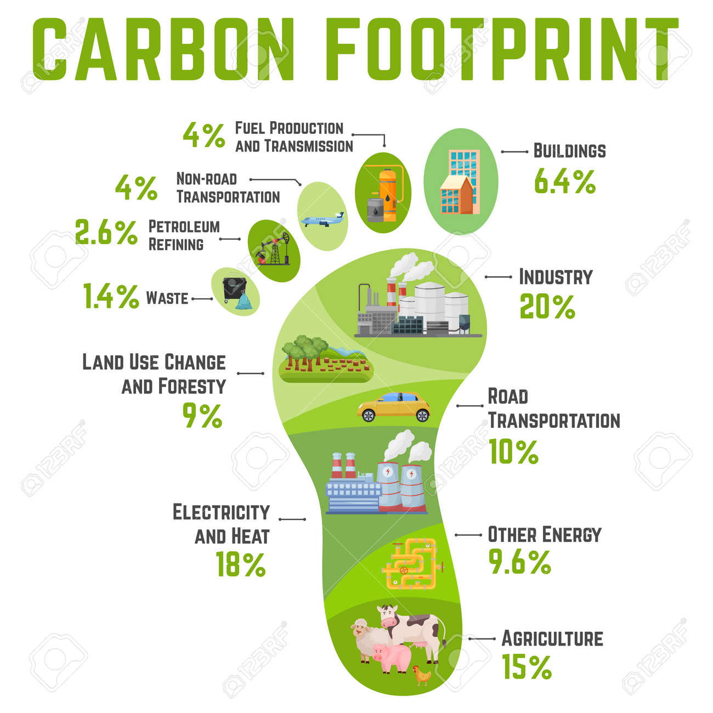
Transitioning to Paperless Database
and Information Systems
Objectives
Introduction
Phase One
Phase Two
Phase Three
Conclusion
Q&A
Digital Transformation in Achieving Defence Information Excellence in the Journey to Greatness

Slide 26
Transitioning to Paperless Database
and Information Systems
Objectives
Introduction
Given that we are a large organization with many tasks that must be accomplished within and outside the borders of the Republic of South Africa, through certain movements, going paperless can help us reduce costs.
Phase One
Phase Two
Phase Three
Conclusion
Q&A
Digital Transformation in Achieving Defence Information Excellence in the Journey to Greatness

Slide 27
Transitioning to Paperless Database
and Information Systems
Objectives
Introduction
We are also responsible for training new recruits and improving skills and capabilities of current employees, therefor going paperless can help us reduce costs in our training institutes, colleges, and training units.
Phase One
Phase Two
Phase Three
Conclusion
Q&A
Digital Transformation in Achieving Defence Information Excellence in the Journey to Greatness

Slide 28
Transitioning to Paperless Database
and Information Systems
Objectives
Introduction
The transition from a traditional paper-based system to a modern paperless system represents a significant step forward in enhancing efficiency, accuracy, and sustainability within organizations.
Phase One
Phase Two
Phase Three
Conclusion
Q&A
Digital Transformation in Achieving Defence Information Excellence in the Journey to Greatness

Slide 29
Transitioning to Paperless Database
and Information Systems
Objectives
Introduction
This journey encompasses various phases, including process mapping, data migration, user training, and system evaluation, each playing a crucial role in ensuring the success of the transition.
Phase One
Phase Two
Phase Three
Conclusion
Q&A
Digital Transformation in Achieving Defence Information Excellence in the Journey to Greatness

Slide 30
Transitioning to Paperless Database
and Information Systems
Objectives
Introduction
Through thorough process mapping, organizations can gain a comprehensive understanding of their existing workflows and identify opportunities for optimization.
Phase One
Phase Two
Phase Three
Conclusion
Q&A
Digital Transformation in Achieving Defence Information Excellence in the Journey to Greatness

Slide 31
Transitioning to Paperless Database
and Information Systems
Objectives
Introduction
As technology continues to evolve, the journey towards digital transformation remains a pivotal avenue for achieving operational excellence and sustainability in an ever-changing business landscape.
Phase One
Phase Two
Phase Three
Conclusion
Q&A
Digital Transformation in Achieving Defence Information Excellence in the Journey to Greatness

Slide 32
OUTCOME
Explain all aspects of Transitioning to Paperless Database and Information Systems according to a comprehensive study on reducing paper usage

Slide 33
SCOPE
Objectives.
Introduction.
Phase One (Current assessment).
Phase Two (Paperless transition & implementation).
Phase Three (Database Integration & Evaluation).
Conclusion.
Q&A

Slide 34
THANKYOU
ANY QUESTIONS?

Slide 35
SANAM SYSTEM

Slide 36
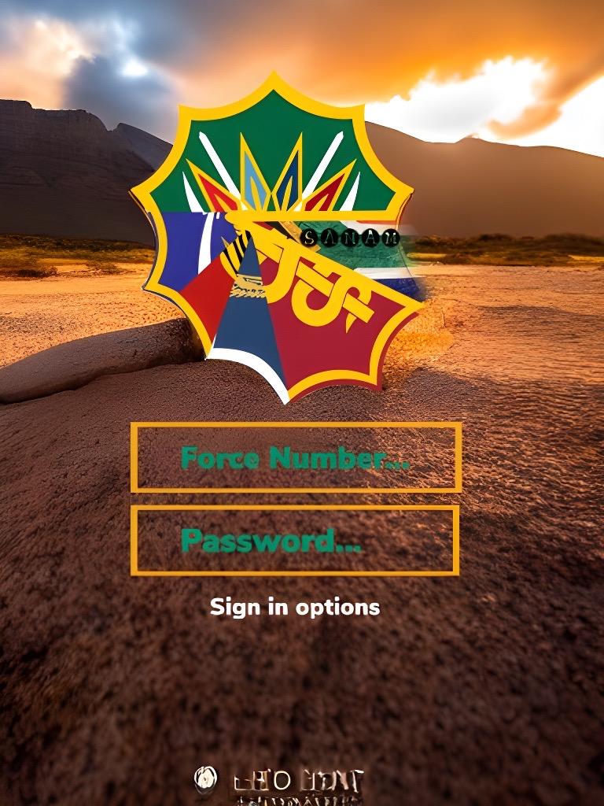
WELCOME TO SANAM SYSTEM

